Slide 1
How Green are the Recovery Plans?
Brussels, 23 March 2021
Daniel Sanz Martínez, Ecology and Development Foundation (ECODES)
Spain
This project has received funding from the European Union’s LIFE programme under grant agreement no. LIFE17 GIC/AT/000039
We acknowledge the support of the European Climate Foundation

Slide 2
SPAIN
Short overview of the Recovery Plan
Status of the Plan
Spain presents their draft of Recovery, Transformation and Resilience Plan with 10 driving policies on October 7, 2020
The final draft will be presented once sent to EC (April)
There is not public information about the final draft and specific projects which are being included.

Slide 3
SPAIN
Short overview of the Recovery Plan
Public consultation
There has been no public consultation for its preparation, nor open participation forums
Initially, companies, civil society and public administrations sent their project proposals to the Government on their own initiative
On December 30, the Government approved Royal Decree-Law (RDL) 36/2020 approving urgent measures for the modernization of the Public Administration and for the execution of the Recovery, Transformation and Resilience Plan
In the last four months, To guarantee the effectiveness of the Plan and ensure efficiency in the development of the different projects in relation to the driving policies and lines of action of the Recovery Plan, several Ministries launched calls for the presentation of “Manifestations of Interest" with the aim of identifying and locating solvent projects with impact and stakeholders interested in developing these actions.
Little transparency and limiting participation and reaction is the general sensation

Slide 4
SPAIN
Short overview of the Recovery Plan
Public consultation / “Manifestations of interest”
Ministries such as the Ecological Transition and the Demographic Challenge or the Transport, Mobility and Urban Agenda, have been the most active in these calls. Some of them have been about…
Ecological Transition and the Demographic Challenge Ministry
Transport, Mobility and Urban Agenda Ministry
Sustainable and Digital Transportation Support Program
Renewable Energy
Local Energy Communities
Plan for sustainable, safe and connected mobility in urban and metropolitan environments (municipalities only)
Electric Mobility: infrastructure for recharging, innovation and electrification of the fleet
A confidential policy about projects presented by stakeholders is in place
As far as we know, only the Industry, Commerce and Tourism Ministry have published a press release with information about one of their “manifestations of interest”. According to it, more than 750 projects were presented with almost 30,000 M€ of investment

Slide 5
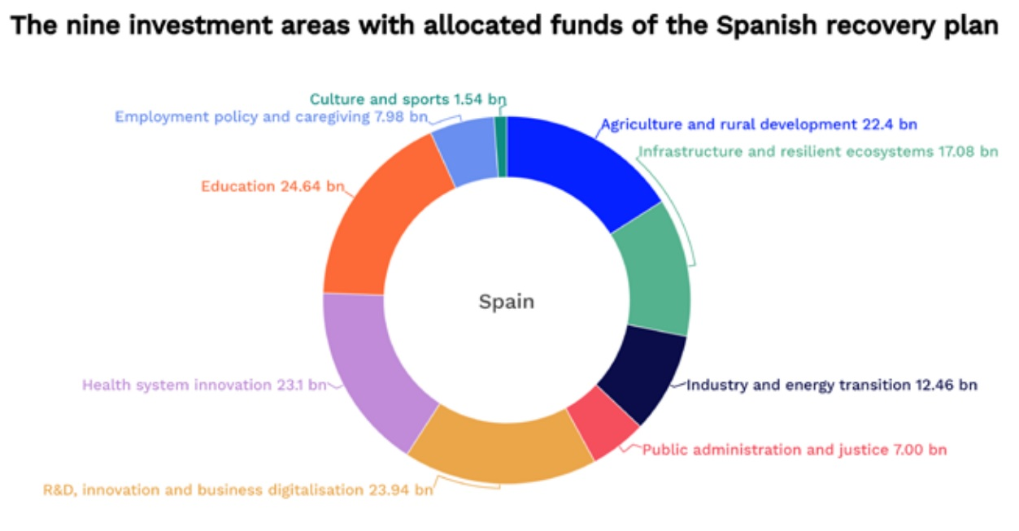
SPAIN
Short overview of the Recovery Plan
In relation with the transport, buildings and agriculture sectors…
This sectors appear in the draft of Spanish Recovery Plan but there is not detailed specific information. They are included in different driving policies.
Notes:
Mainly in: agriculture and rural development, infraestructura and resilient ecosystems and indrustry and energy transition.

Slide 6
SPAIN
Short overview of the Recovery Plan
3.1. Transport and mobility (examples)
Positive
Negative
Low Emission Zones
Charging infrastructure
Renewal of public transport fleets
Biogas support
Nothing about decarbonization of maritime and air sector or electrification of heavy road transport
Nothing about rail or active mobility / micro-mobility
Notes:
Lack of details, implementarion, schedule, criteria and impact objetives

Slide 7
SPAIN
Short overview of the Recovery Plan
3.2. Building (examples)
Positive
Negative
Self-consumption, local energy communities and “solar roofs”
Building rehabilitation and urban renovation
Energy efficiency measures and deployment of renewable energies
Detailed plan for elimination of fossil fuels
Measures for the protection of the territory, landscapes and biodiversity in the process of deployment of wind and solar infrastructure
Elimination targets for polluting heating and cooling systems
Notes:
Lack of details, implementarion, schedule, criteria and impact objetives

Slide 8
SPAIN
Short overview of the Recovery Plan
3.3. Agriculture (examples)
Positive
Negative
Promotion of organic and ecological production
Promotion of local, seasonal and proximity consumption
Food waste reduction policies
Measures to reduce emissions from the sector are not included
Measures to improve the energy efficiency of buildings (farms or explotation factories) are not included
Measures to control pollution and waste and to protect nature from the expansión of agriculture and livestock factories
Notes:
Lack of details, implementarion, schedule, criteria and impact objetives

Slide 9
SPAIN
Consistency between measures in the Recovery Plans and the National Energy and Climate Plans (NECPs)
The EC valued the Spanish NECP very positively
The measures included in the NECP are included in the Recovery Plan (Some of them have been named in previous slides)
The Recovery Plan includes lines of action inside driving policies that are not included in the NECP due to the global and transversal nature of the policies included in the Recovery Plan since it has been developed for a post-COVID-19 period while the NECP was designed before.
Commitments to Policy Reforms – Use of fiscal instruments
The Recovery Plan recognizes the shortcomings of the Spanish tax system. Among other, environmental taxation
Creation of an expert group for tax reform
In the short term, among other: reinforcement of the system’s collection capacity and the implementation of different projects to improve environmental taxation, as well as adjustments to existing taxes to reinforce their effectiveness, eliminate some dysfunctions and adapt incentives to boost economic activity and employment
Reforms commitments are not specified
The tenth driving policy is the modernization of the tax system for inclusive and sustainable growth,
but the current draft of recovery plan doesn’t specify how much funding will be allocated.

Slide 10
SPAIN
Final recommendations for the way forwards
Transparency
Participation
Schedule
Detail of the distribution of investments and to what and to whom they are granted
Impact measurement (emission reduction, job creation, investments, etc.)
Prioritization of key sector which have greatest potential for transforming the economy and reach climate and environmental goals
Measures for protection of territories and biodiversity
Regulation and specific legislation on key issues
Revision of NECP goals to adapt them to the increase of ambition agreed by Europe
National and regional political commitment and stability

Slide 11
Thank you
Daniel Sanz Mónica Vidal Cristian Quílez
daniel.sanz@ecodes.org monica.vidal@ecodes.org cristian.quilez@ecodes.org
Ecology and Development Foundation (ECODES)
ecodes.org / (+ 34) 976 29 82 82
Spain
This project has received funding from the European Union’s LIFE programme under grant agreement no. LIFE17 GIC/AT/000039
We acknowledge the support of the European Climate Foundation

